Slide 1
Network and Network Security Concepts
Liu Cui

Slide 2
Road Map
Review of Network
Network Security Issues
The Link Layer
The Network Layer
The Transport Layer
The Application Layer and DNS

Slide 3
Review of Network
Network Topology
LAN vs WAN
Autonomous System
Internet Protocol Stack
TCP/IP Layers and function
TCP/IP Encapsulation

Slide 4
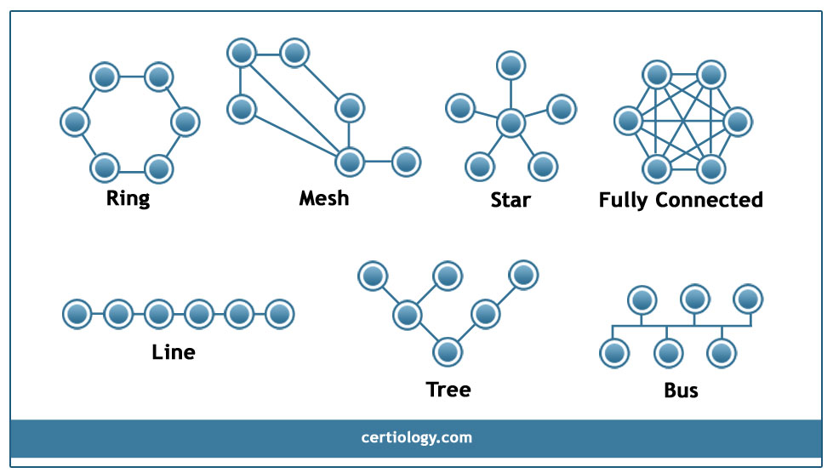
Network Topology

Slide 5
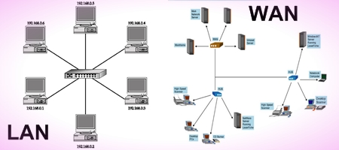
LAN and WAN

Slide 6
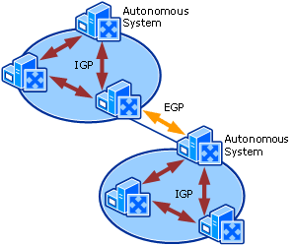
Autonomous System

Slide 7
Internet Protocol Stack
The architecture of the Internet is modeled conceptually as being partitioned into layers, which collectively are called the Internet protocol stack
Each layer provides a set of services and functionality guarantees for higher layers and, to the extent possible, each layer does not depend on details or services from higher levels.
The interface each layer provides to higher levels is designed to provide only the essential information from this layer that is needed by the higher levels –lower-level details are hidden from the higher levels.
OSI: 7 layers; TCP/IP: 5 layers

Slide 8
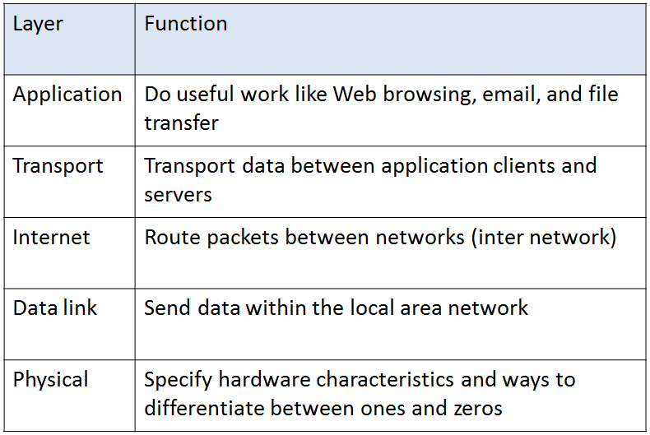
TCP/IP
Notes:
Physical Layer: the task of the physical layer is to move the actual bits between the nodes of the network, on a best effort basis. For example, this level deals with details related to whether connections are done with copper wires, coaxial cables, optical-fiber cables, or wireless radio. The abstraction it provides to the next higher level is an ability to transmit bits between a pair of network nodes.
Link Layer: The task of the link layer is to transfer data between a pair of network nodes or between nodes in a local-area network and to detect errors that occur at the physical layer. The layer, for instance, deals with the logical aspects of sending information across network links and how to find good routing paths in a local-area network. It includes such protocols as Ethernet, which is used to route packets between computers sharing a common connection. The link layer provides a grouping of bits into ordered records, called frames. The link layer uses 48-bit addresses, called media access control address (MAC address)
Network Layer: The task of the network layer, which is also known as the Internet layer for the Internet, is to provide for the moving of packets between any two hosts, on a best effort basis. It provides a way of individually addressing each host using a numerical label, called its IP address. The main protocol provided by this layer is the Internet Protocol (IP), which is subdivided into a version 4 (IPv4), which uses 32-bit IP addresses, and a version 6 (IPv6), which uses 128-bit IP addresses. Best effort basis means there are no guarantees that any given packet will be delivered. Thus, if reliable delivery is required by an application, it will have to be provided by a higher layer.
Transport Layer: The task of the transport layer is to support communication and connections between applications, based on IP addresses and ports, which are 16-bit addresses for application-level protocols to use. The transport layer provides a protocol, the Transmission Control Protocol (TCP), which establishes a virtual connection between a client and server and guarantees delivery of all packets in an ordered fashion, and a protocol, the User Datagram Protocol (UDP), which assumes no prior setup and delivers packets as quickly as possible but with no delivery guarantees.
Application Layer: The task of the application layer is to provide protocols that support useful functions on the Internet, based on the services provided by the transport layer. Examples include HTTP, which uses TCP and supports web browsing, DNS, which uses UDP and supports the use of useful names for hosts instead of IP addresses, SMTP and IMAP, which use TCP and support electronic mail, SSL, which uses TCP and supports secure encrypted connections, and VoIP, which uses UDP and supports Internet telephone messaging.

Slide 9
TCP/IP Encapsulation
The Internet was designed so that communication occurs through sequences of data packets.
A data packet is a finite-length set of bits, which is divided into two parts:
A header: specifies where the packet is going and contains control information, various overhead and bookkeeping details
Payload: actual information that is being communicated.

Slide 10
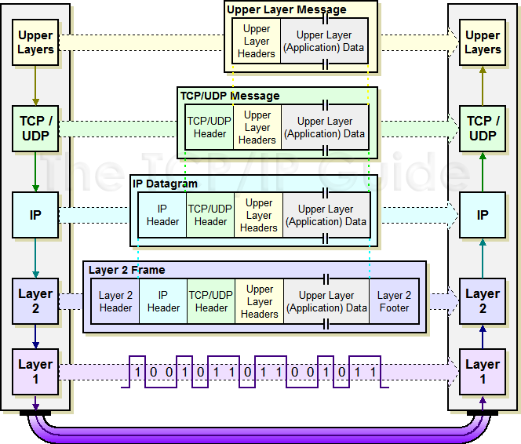
TCP/IP Encapsulation

Slide 11
Network Security Issues
Confidentiality
Integrity
Availability
Assurance
Authenticity
Anonymity

Slide 12
Network Security Issues
Confidentiality
There is no requirement, in any of the layering abstractions discussed above, that the contents of the network packets be kept confidential.
In fact, standard protocols for each layer don’t encrypt the contents of either their headers or their data.
Thus, if network communications should be kept confidential, then encryption should be done explicitly.
This encryption could either be done at the application layers (HTTPS) or by revising a lower layer protocol to include encryption (IPsec)
Notes:
Connecting computers to a network, like the Internet, so they can exchange data and share computations allows for huge benefits to society. But computer networking also allows for a number of attacks on computers and information.

Slide 13
Network Security Issues
Integrity
The headers and footers that encapsulate data packets have, at each layer, simple checksums to validate the integrity of data and/or header contents.
These checksums are effective at determining if a small number of bits have been altered, but they are not cryptographically secure, so they don’t provide integrity in the computer security sense.
Thus, if true integrity is required, then this should also be done at the application layer or with alternative protocols at lower layers.

Slide 14
Network Security Issues
Availability
The Internet was designed to tolerate failures of routers and hosts
But the sheer size of the Internet makes availability a challenge for any network object that needs to be available on a 24/7 basis.
Web servers can become unavailable because they become bombarded with data requests
Such requests could come from hoards of legitimate users or from an attack coming from many compromised hosts
Thus, to achieve availability at the scale of the Internet, we need network applications that can scale with increases in communication requests and/or block attacks from illegitimate requests.

Slide 15
Network Security Issues
Assurance
As a default, a packet is allowed to travel between any source and destination in a network.
Thus, if we want to introduce permissions and policies that control how data flows in a network, these have to be implemented as explicit additions.
For example, network firewalls are designed to block traffic in and out of a network domain if that traffic violates policies set by administers.

Slide 16
Network Security Issues
Authenticity
The headers and footers for the standard Internet protocols do not have a place to put digital signatures.
Indeed, in the Internet Protocol stack, there is no notion of users identities.
Data is exchanged between machines and processes, not people.
Thus, if we want to introduce identities and allow for signatures, then we must do so explicitly at the application layer or with an alternative protocol.

Slide 17
Network Security Issues
Anonymity
Since there is no default notion of identity of users of the Internet, it has a built-in anonymity.
It could means both good and bad
Attacks on anonymity can come from technologies that identify the computer a person is using.
Likewise, people can replicate many copies of a process and place these copies at multiple hosts in the network, thus achieving a level of anonymity.

Slide 18
The Link Layer
Ethernet
Medium Access Control
Link Layer Devices: Hubs and Switches
Media Access Control (MAC) Addresses
Link Layer Attack: ARP Spoofing
Defend ARP Spoofing

Slide 19
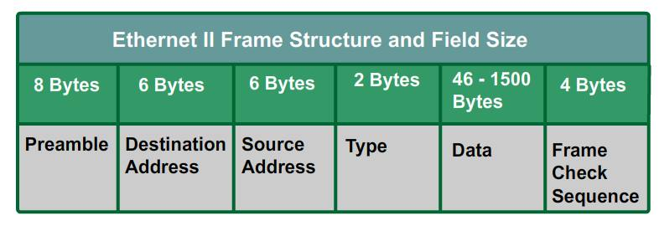
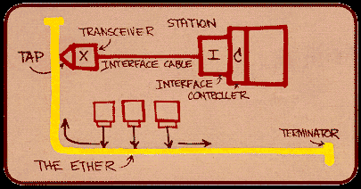
Ethernet
One of the most popular ways to transmit Internet traffic is Ethernet, which refers to both the physical medium used (typically a cable) as well as the link-layer protocol standardized as IEEE 802.3.
When a frame is transmitted on an Ethernet cable, an electrical impulse is sent through that cable and received by other machines that are logically connected to that cable on the same local-area network (LAN)

Slide 20
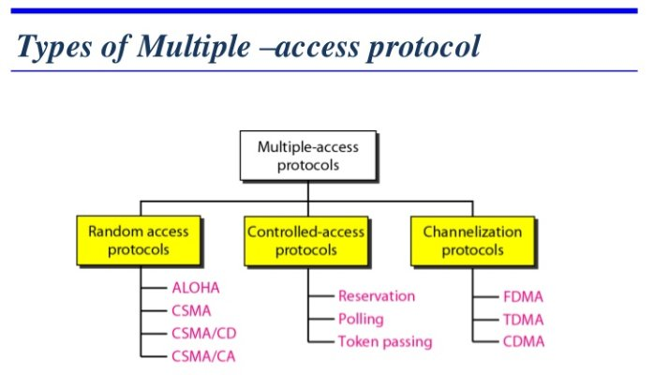
Link Layer: Medium Access Contol

Slide 21
Link Layer Devices: Hubs and Switches
Notes:
The simplest way to connect machines in a local-area network is to use an Ethernet hub, which is a device that logically connects multiple devices together, allowing them to act as a single network segment. Hubs typically forward all frames to all attached devices, doing nothing to separate each attached device. Thus, the machines that are connected to a hub, or a set of connected hubs, form a single network segment and must all participate in the Ethernet collision resolution protocol. Hubs may generate large amounts of unnecessary traffic, since each frame is duplicated and broadcast to all the machines connected on the same network segment. In addition, the fact that all frames are forwarded to each machine in the segment, regardless of the intended destination, increases the ease of network eavesdropping.
Fortunately, these is a better way to connect machines in a small local area network—namely, to use an Ethernet switch. When devices are first connected to an Ethernet switch, it acts much like a hub, sending out frames to all connected machines. Over time, however, a switch learns the addresses of the machines that are connected to its various ports. Given this address information, a switch will then only forward each frame it receives along the cable it knows is connected to the destination for that frame. Even so, if a frame is designated as one that should be broadcast to all the machines on a network segment, a switch will still act like a hub and send that frame out to all its connected machines.
The selectivity that comes from a switch learning the addresses of the machines it connects reduces the possibilities for collisions and increases the effective speed of the network, that is its effective bandwidth. In addition, a switch reduces the risks of network eavesdropping, since network frames forwarded by a switch are less likely to be seen by machines that are not destinations. Due to decreasing costs in networking technology, switches have become the de facto standard for link layer data forwarding.

Slide 22
Media Access Control (MAC) Addresses
A MAC address is a 48-bit identifier (24 bits are a prefix identifying the organization issued by IEEE) assigned to a network interface by its manufacturer.
MAC addresses are used in the link layer to identify the devices in a network; hence, MAC addresses are intended to be unique for each interface.
Despite the fact that they are designed to be unique identifiers, MAC addresses can be changed by software through the driver of the network interface.

Slide 23
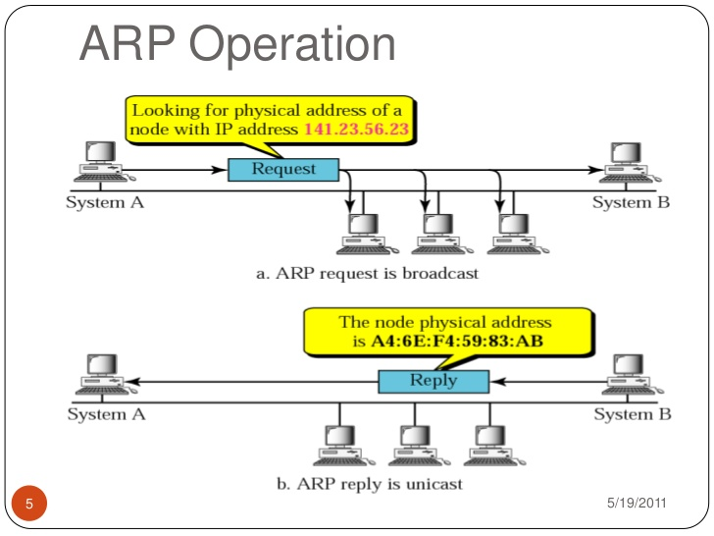
Link Layer Protocol: ARP
The Address Resolution Protocol (ARP) is a link-layer protocol that provides services to the network layer.
ARP is used to find a host’s hardware address (MAC address) given its network layer address (IP address)
Notes:
This request is sent to all the machines on the local-area network. This ARP reply is transmitted in a frame addressed only to the machine that made the ARP request. When this machine receives the ARP reply, it stores the IP-MAC address pair locally in a table, called its ARP cache, so it does not have to continually resolve that particular IP address. After this ARP resolution, the source can finally send its data to its destination.
The ARP protocol is simple and effective, but it lacks an authentication scheme. Any computer on the network could claim to have the requested IP address.
In fact, any machine that receives an ARP reply, even if it was not proceeded by a request, will automatically update its ARP cache with the new association. Because of this shortcoming, it is possible for malicious parties on a ALN to perform the ARP spoofing attack.

Slide 24
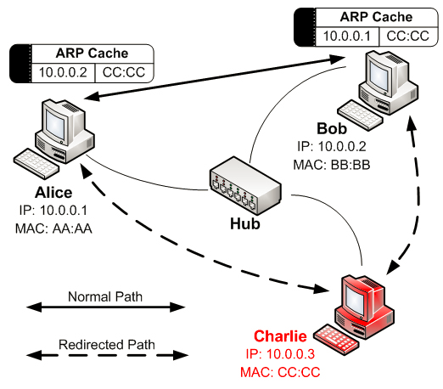
Link Layer Man-in-the-Middle Attack: ARP Spoofing
Notes:
This attack is relatively straightforward. An attacker, Charlie, simply sends an ARP reply to a target, who we will call Alice, who associates the IP address of Bob, with Charlie’s MAC address. Charlie also sends an ARP reply to Bob associating Alice’s IP address with Charlie’s MAC address. After this ARP cache poisoning has taken place, Bob thinks Alice’s IP address is associated with Charlie’s MAC address and Alice thinks Bob’s IP address is associated with Charlie’s MAC address. Thus, all traffic between Alice and Bob is routed through Charlie.

Slide 25
Defend ARP Spoofing
Checking for multiple occurrences of the same MAC address on the LAN, which may be an indicator of possible ARP spoofing
Static ARP tables: requires a network administrator to manually specify a router’s ARP cache to assign certain MAC addresses to specific IP addresses
Software, such as anti-arpspoof, Xarp, and Arpwatch, inspect all ARP packets and compare their contents with stored records of ARP entries to detect spoofing

Slide 26
The Network Layer
Internet Protocol Review
Internet Control Message Protocol (ICMP)
IP Spoofing
Packet Sniffing

Slide 27
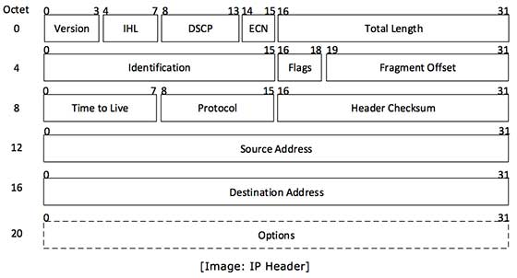
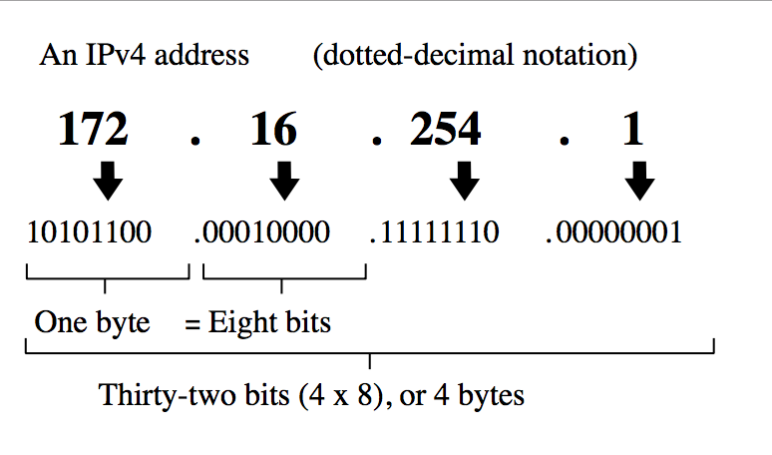
Network Layer: Internet Protocol (IP)
The Internet Protocol (IP) is the network-level protocol that performs a best effort to route a data packet from a source node to a destination node in the Internet.
In IP, every node is given a unique numerical address, which is a 32-bit number under version 4 (IPv4) and is 128 bit number under version 6 (IPv6)

Slide 28
Routing IP Packets
A host such as a desktop PC, server, or smartphone, employs a simple algorithm for routing packets from that host:
If the packet is addressed to a machine on the same LAN as the host, then the packet is transmitted directly on the LAN, using the ARP protocol to determine the MAC address of the destination machine.
If the packet is addressed to a machine that is not on the LAN, then the packet is transmitted to specially designated machine on the LAN, called a gateway, which will handle the next step of the routing. The ARP protocol is used to determine the MAC address of the gateway.
Gateways and other intermediate network nodes that handle the routing of packets on the Internet are called routers. For each packet, the router performs one of three possible actions
Drop: if the packet is expired, it is dropped
Deliver: if the destination is a machine on one of the LANs to which the router is connected
Forward: if the destination of the packet does not belong to the LANs of the router, the router forward the packets to the next router based on routing tables.

Slide 29
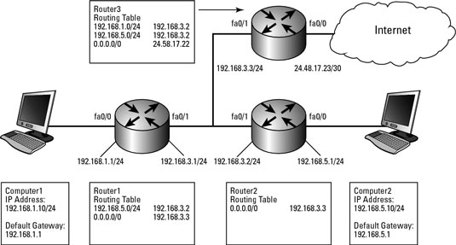
Routing IP Packet

Slide 30
Internet Control Message Protocol
ICMP is a network-layer protocol that is used by hosts to perform a number of basic testing and error notification tasks
ICMP is primarily used for network diagnostic tasks, such as determining if a host is alive and finding the path followed by a packet.
ICMP packets carry various types of messages, including the following:
Echo request: Asks the destination machine to acknowledge the receipt of the packet
Echo response: Acknowledges the receipt of a packet in reply to an echo request
Time exceeded: Error notification that a packet has expired, that is, it TTL is zero
Destination unreachable: Error notification that the packet could not be delivered

Slide 31
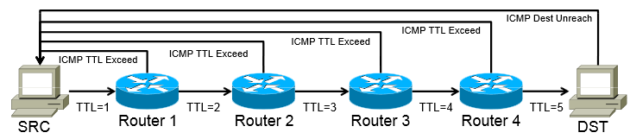
Internet Control Message Protocol
Ping uses the ICMP protocol to verify whether or not a particular host is receiving packets
Traceroute uses ICMP messages to determine the path a packet takes to reach another host, either on a local network or on the Internet.
Notes:
Traceroute accomplishes this task with a clever use of the time-to-live (TTL) filed in the IP header. First, it attempts to send a packet to the target with a TTL of 1. On receiving a packet with a TTL of 1, an intermediate router discards the packet and replies to the sender with an ICMP time exceeded message, revealing the first machine along the path to the target. Next, traceroute sends a packet with a TTL of 2. On reaching the first router in the path, the TTL is decremented by one an forwarded to the next router, which in turn sends an ICMP packet to the original sender. By incrementing the TTL field in this way, traceroute can determinie each host along the path to the target.

Slide 32
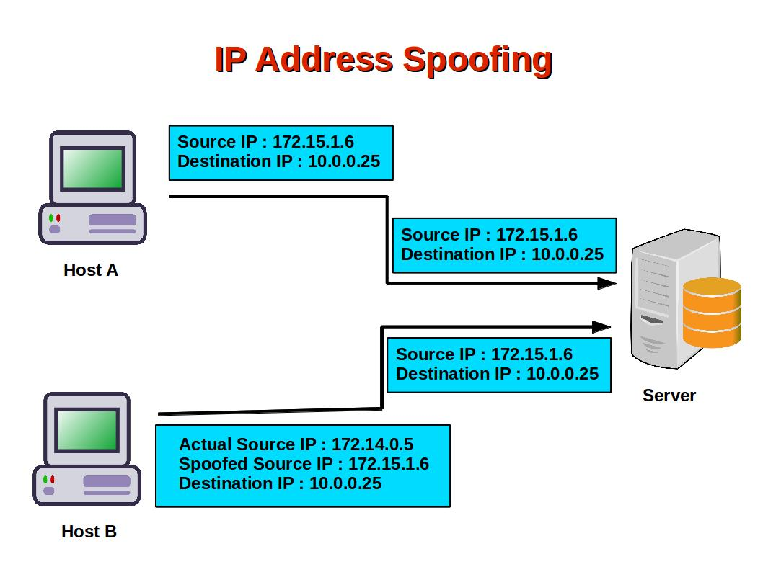
IP Spoofing
Each IP packet includes source IP address, which is never checked.
It is trivial for anyone to specify a source address that is different from their actual IP address
Who receive the response?
The machine with spoofed IP address
Therefore, if an attacker is using IP spoofing on this outbound packets, he must either not care about any responses (DOS attack) or he has some other way of receiving responses.

Slide 33
Dealing with IP Spoofing
Border routers: block packets from outside their administrative domain that have source addresses from inside that domain
IP traceback: tracing the path of a packet back to its actual source address. Then block the packet from that location.

Slide 34
Packet Sniffing
Because most data payloads of IP packets are not encrypted, the Internet Protocol allows for some types of eavesdropping.
When frames are transmitted over an Ethernet network, they are received by every device on the same network segment. Each network interface in this segment will normally compare the frame’s destination MAC address with its own MAC address, and discard the frame if it doesn’t match. If a network interface is operating in promiscuous mode, however, it will retain all frames and read their contents.

Slide 35
Defenses Against Packet Sniffing
Use Ethernet switches as opposed to hubs (note that there is no analog to the switch when communicating wirelessly, however. Since all wireless traffic is transmitted over the air, any deice on the same wireless network may sniff traffic from any other device.)
Encryption
Preventing unauthorized access to a private network.

Slide 36
The Transport Layer
Transmission Control Protocol (TCP)
User Data Protocol (UDP)
Network Address Translation (NAT)
TCP Session Hijacking

Slide 37
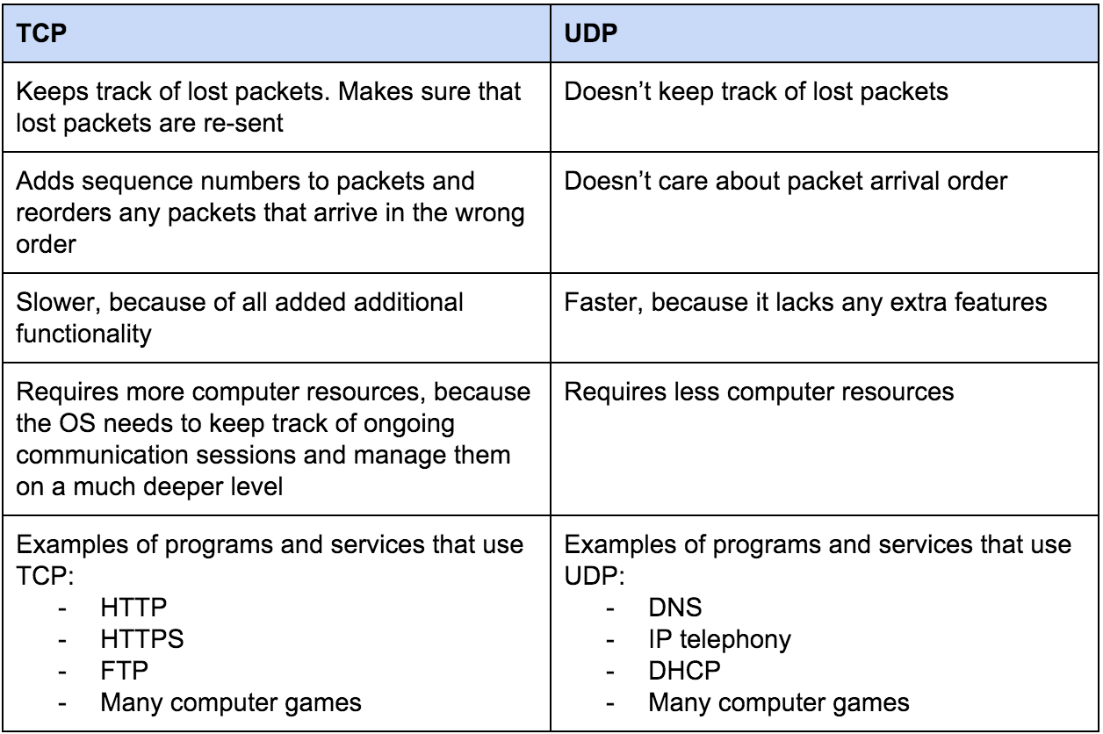
TCP and UDP Comparison

Slide 38
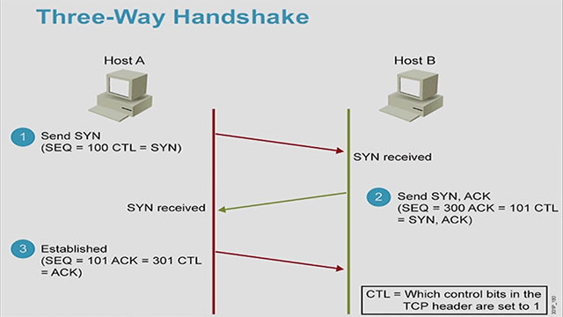
TCP Three-Way Handshake

Slide 39
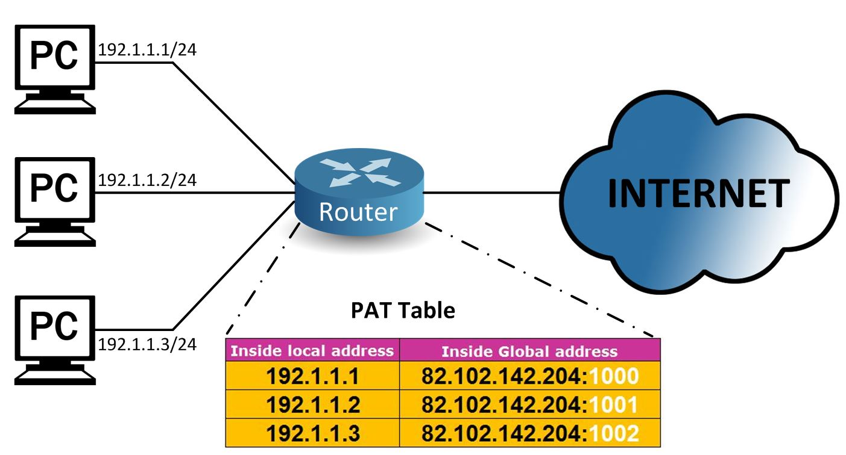
Network Address Translation (NAT)

Slide 40
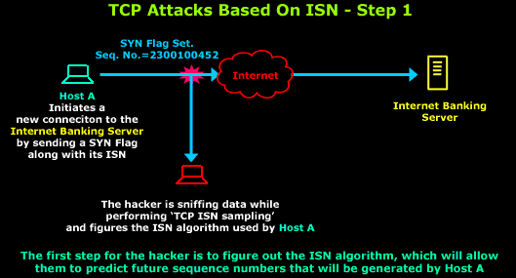
TCP Session Hijacking
Attacker hijack or later a TCP connection from another user
TCP Sequence Prediction
Notes:
The attacker sniffing data while performing TCP ISN sampling. It need to guess the SYN used by the server
The attacker sends a SYN packet to the target server, spoofing the source IP address to be that of the client victim.
After waiting a short period of time for the server to send a reply to the client (which is not visible to the attacker and is not acted on by the client due to the DOS attack), the attacker concludes the TCP handshake by sending an ACK packet with the sequence number set to a prediction of the next expected number (based on information gathered by other means), again spoofing the source IP to be that of the client victim.
The attacker can now send requests to the server as if he is the client victim.

Slide 41
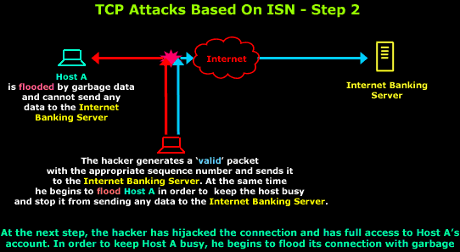
TCP Session Hijacking
Attacker hijack or later a TCP connection from another user
TCP Sequence Prediction

Slide 42
TCP Session Hijacking
Blind Injection
Note that the above attack only allows one-way communication, since the attacker cannot receive any replies from the server due to the user of IP spoofing.
Nevertheless, this method may allow an attacker to subvert a system that executes certain commands based on the source IP address of the requester.
This type of attack is known as blind injection, because it is done without anticipating being able to see the server’s response.
Alternatively, it may be possible to inject a packet containing a command that creates a connection back to the attacker.

Slide 43
TCP Session Hijacking
ACK Storms
A possible side-effect of a blind injection attack is that is can cause a client and server to become out-of-synchronization with respect to sequence numbers, since the server got a synchronized message the client never actually sent. TCP incorporates a method for clients and servers to become resynchronized when they get out of step, but it doesn’t easily tolerate the kind of desynchronization that happens after a blind injection attack.
So, after such an attack, the client and server might start sending ACK messages to each other, each trying to tell the other to start using “correct” sequence numbers. This back-and-forth communication is known as an ACK storm, and it can continue until one of these messages is lost by accident or firewall detects an ACK storm in progress and discards a bad ACK message.

Slide 44
TCP Session Hijacking
Complete Session Hijacking
When an attacker is on the same network segment as the target server or client, an attacker can completely hijack an existing TCP session.
Combine ARP spoofing and packet sniffing

Slide 45
TCP Session Hijacking Countermeasures
Encryption
Authentication

Slide 46
The Application Layer
A Sample of Application-Layer Protocols
The Domain Name System (DNS)
DNS Attack
Syslog message logging protocol

Slide 47
A Sample of Application-Layer Protocols
Domain Name System (DNS)
Hyptertext Transfer Protocol (HTTP)
SSL/TLS
IMAP/POP/SMTP
File Transfer Protocol (FTP)
SOAP: exchanging structured data as a part of the web services paradigm
Telnet
SSH

Slide 48
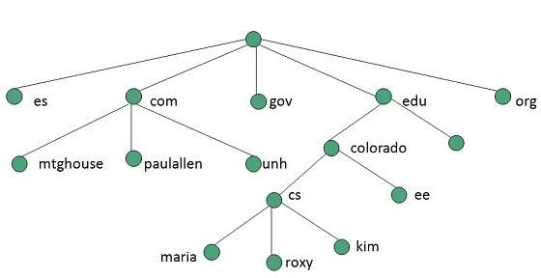
Domain Name System—How DNS is Organized
Notes:
There are two primary types of top-level domains in use today:
Generic top-level domains, such as the popular domains .com, .net, .edu, and .org
Country-code top-level domains, such as .au, .de, and .it, with use restricted to entities within a specific country.
Domain names are registered and assigned by domain-name registrars, which are organizations accredited by the Internet Corporation for Assigned Names and Numbers (ICANN), the same group responsible for allocating IP address space, or a country-code top-level domain that has been granted authority to designate registrars. Web site owners wishing to register a domain name can contact a domain-name registrar to reserve the name on their behalf.
Domain names are arranged in a hierarchy that can be read by examining a domain name from right to left. For example, www.example.com has a top level domain of com, with example.com being a subdomain of com, and www.example.com being a subdomain of example.com. More formally, domain names form a rooted tree, where each node corresponds to a domain and the children of a node correspond to its subdomains. The root is the empty domain name and the childrenof the root are associated with top-level domains.

Slide 49
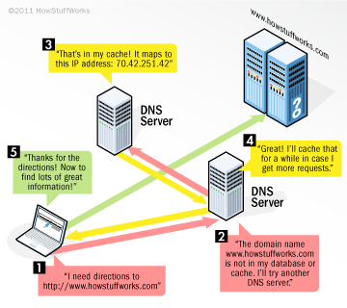
Domain Name System – How DNS Queries Work
Notes:
The hierarchical nature of domain names is reflected in the way the Internet infrastructure supporting the DNS system works. That is, to resolve domain name to its corresponding IP address, the DNS hierarchy is used to query a distributed system of DNS servers, known as name servers. At the top of the name-server hierarchy are the root name servers, which are responsible for top-level domains, such as .com, .it, .net, and .org. Specifically, the root name servers store the roote zone database of records indicating the authoritative name server of each top-level domain. This important database is maintained by ICANN. The name servers of each top-level domain are managed by government and commercial organizations. For example, the name servers for the .com TLD are managed by VeriSign, a company incorporated in the U.S., while the name servers for the .it TLD are managed by the Italian National Research Council, an Italian government organization. In turn, the TLD name servers store records for the authoritative name servers of their respective subdomains. Thus, the authoritative name servers are also organized in a hierarchy.
When a client machine wishes to resolve a domain name such as www.example.com to an IP address, it contacts a designated name server can be, for example, a name server of the corporate network to which the client machine belongs, or a name server of the Internet service provider. The designated name server handles the resolution of the domain name and returns the result to the client machine, as follows.
First, the designated name server issues a DSN query to a root name server. The root server then responds with the address of the server that is authoritative for the next level of the hierarchy –in this example, it would reply with the address of the name server responsible for the .com top-level domain name. On querying this next-level server, it would respond with the address of the name server responsible for the next-level server, it would respond with the address of the name server responsible for the next subdomain, which in this case is example.com. This sequence of the requests and responses continues until a name server responds with the IP address of the requested domain.

Slide 50
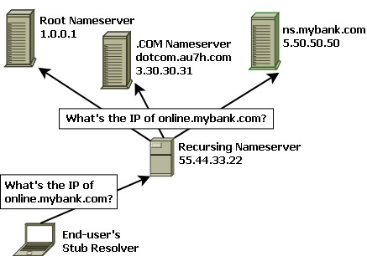
Domain Name System – DNS Caching
Notes:
Since DNS is a central service utilized by billions of machines connected to the Internet, without any additional mechanisms, DSN would place an incredible burden on high-level name servers, especially the root name servers. In order to reduce DSN traffic and resolve domain names more efficiently, DNS features a caching mechanism that allows both clients and lower-level DSN servers to keep a DNS cache, a table of recently received DNS records. A name server can then use this cache to resolve queries for domain names it has recently answered, rather than consuming the resources of higher-level name servers. This caching system therefore overcomes the problem of massive amounts of traffic directed at root name servers by allowing lower-level name servers to resolve queries.

Slide 51
DNS Attacks
Pharming and Phishing
An attacker could cause requests for web sites to resolve to false IP addresses of his own malicious servers, leading the victim to view or download undesired content, such as malware. Such an attack is known as pharming
One of the main uses of pharming is to resolve a domain name to a web site that appears identical to the requested site, but is instead designed for a malicious intent. Such an attack is known an phishing and it can be used to try to grab usernames and passwords, credit card numbers, and other personal information

Slide 52
DNS Attacks
DNS Cache Poisoning
An attacker attempts to trick a DNS server into caching a false DNS record, which will then cause all downstream clients issuing DNS requests to that server to resolve domains to attacker-supplied IP addresses.

Slide 53
Defend DNS – DNSSEC
DNSSEC is a set of security extensions to the DNS protocol that prevent attacks such as cache poisoning by digitally signing all DNS replies using public-key cryptography.
Such signatures make it infeasible for an attacker to spoof a DNS reply and thereby poison a DNS cache.

Slide 54
A Sample of Application-Layer Protocols
Hypertext Transfer Protocol Secure (HTTPS)
SSL/TLS
SSH
Syslog Message Logging Protocol

Slide 55
Syslog Message Logging Protocol
Syslog is a standard for message logging.
It allows separation of the software that generates messages, the system that stores them, and the software that reports and analyzes them.
Each message is labeled with a facility code, indicating the software type that generating the message, and assigned a severity label.
Syslog Message Logging Protocol is used for
System management
Security auditing
General information
Analysis, and debugging messages
Convey event notification messages
Providing a message format that allows vendor-specific extensions to be provided in a structured way

Slide 56
Syslog Message Logging Protocol
Syslog utilizes three layers:
Syslog content: information contained in a message
Syslog application: handles generation, interpretation, routing and storage of syslog messages
Syslog transport: puts the messages on the wire and takes them off the wire.
Functions are performed at each conceptual layer:
An “originator” generates syslog content to be carried in message (router, server, switch, network device, etc)
A “collector” gathers syslog content for further analysis
A “relay” forwards messages, accepting messages from originators on other relays and sending them to collectors or other relays
A “transport sender” passes syslog messages to a specific transport protocol
A “transport receiver” takes syslog messages from a specific transport protocol

Slide 57
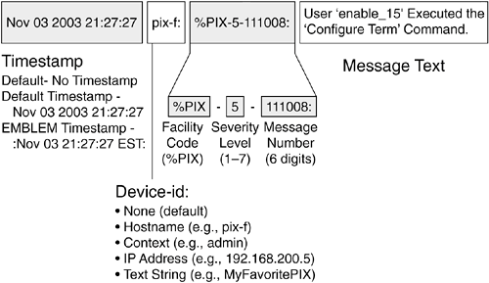
Syslog Message Logging Protocol
Syslog message components
The information provided by the originator of a syslog message includes the facility code and the severity level
The syslog software adds information to the information header before passing the entry to the syslog receiver.
Originator process ID
A timestamp
The hostname or IP address of the device
Facility code
The facility value indicates which machine process created the message. The syslog protocol was originally written on BSD Unix, so facilities reflex the names of UNIX processes and daemons.

